Slide 1

FCS and Rural Development
Rural Families Speak Project
Rural Families Speak
Ann A. Berry, Ph.D., The University of Tennessee
2016 SR-PLN AEA ASRED
August 24, 2016
Nashville, Tennessee
This study is based on data from the cooperative multi-state research project, NC1171 “Interactions of Individual, Family, Community, and Policy Contexts on the Mental
and Physical Health of Diverse Rural Low Income Families” (commonly known as Rural Families Speak about Health).

Slide 2
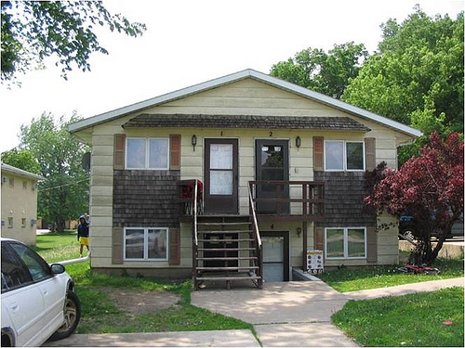
National Information Management & Support System
Approved Research Project
NC223, NC1011, NC1171
Rural Families Speak
Longitudinal study
1998-2019
Multistate
Total of 23 states involved
Multidisciplinary
*Key factor in project success
Mixed methods approach
Questionnaires
Face to Face Interviews
Focus Groups
Phone Interviews

Slide 3
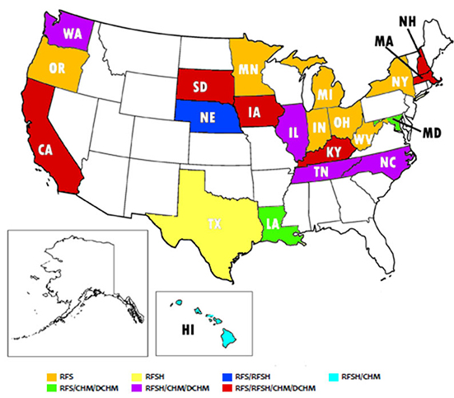
Multistate, Multidisciplinary Project History
Rural Families Speak
Rural Families Speak (RFS)
NC223/1011 1998-2008
Rural Families Speak About Health (RFSH)
NC1171 2008-2014
NC1171 2014-2019
Core Health Messages 2010-2011
Dissemination of
Core Health Messages 2011-2012
Member States
Additional State Reps attending
2015 meeting
FL, MS, VA, KS, PA, NM, AZ

Slide 4
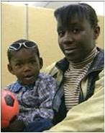
Rural Families Speak
Rural Families Speak
(RFS)
Goal: Longitudinal research project focusing on functioning and well-being of rural low income families in context of welfare reform
1998-2008
Multi-state project with 17 universities sponsored by Agricultural Experiment Stations and Cooperative Extension Services; awarded USDA/CSREES National Research Initiative Cooperative Grants Program (NRICGP) grants (2001-30541-10215, 2002-35401-11591, and 2004-35401-14938)
17 States: CA, IA, IN, KY, LA, MD, MA, MI, MN, NE, NH, NY, OH, OR, SD, WY(wave1 only), WV

Slide 5
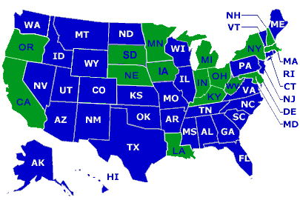
Rural Families Speak
Participating States

Slide 6
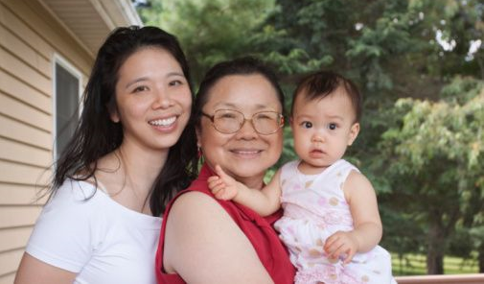
Rural Families Speak
Theoretical Frameworks
Human Ecology and Family Ecology Theories
Human Capital Theory
Others specific to research questions and discipline
Multidisciplinary approach to tell the stories of
the families holistically

Slide 7

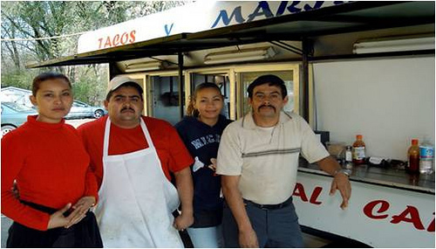

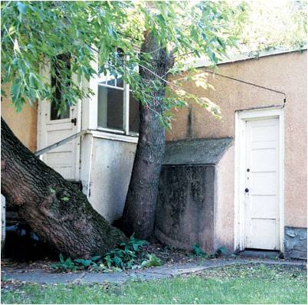
Rural Families Speak
Research questions designed to tell the mothers’ stories
Economic Well-Being
Housing
Parenting
Mental Health
Physical Health
Employment
Child Care
Transportation
Work and Family Balance
Living in the Community
Family Functioning
Social Supports
Food Security

Slide 8
Rural Families Speak
Quotes from mothers
Some of the mothers faced short-term health problems or minor disabilities (including pregnancy-related issues) that interrupted their employment trajectories leaving them unable to work for short periods of time and/or at certain types of jobs. Taffy, a 27-year-old single mother of two young daughters described her battle with short-term health issues.
I was terminated while I was in the hospital…this one was for depression, I had to end up having a nervous breakdown, and they admitted me right then and there, so I was in a position where I couldn't call. I wasn't allowed to call or anything…
“Basically, the reason why I want to quit is just because my job takes too much of my time, and I hardly see my kids. I hardly spend any time with them. And so I figure I'll just get a part time job and go to school. And it'll be like I still have my job. I'll struggle for a little bit, but, for, to better myself in the future.”
Sometimes having flexibility was more important than being paid well. Being asked what her ideal job was, Raven, a single mother of two school-age children responded, “I don’t get paid for the summer, but I have the summer off with the kids. That’s why I jumped at this job.” Another mother, Leandra, an administrative assistant, described how her supervisors understood her responsibility as a mother.
…they do more of a flex time for this…the little one [youngest child] is going to the pumpkin farm for the first time, with the Head Start, and I wanted to take off time to go to that…and they said, “That’s fine, if you want, you can work through your lunch and just add time on the end, or if you want, just come in like a half and hour early, you know, to make up for some of the time.”…See, and you don’t find too many offices that let you do that. And I think the whole reason is that most of the supervisors are very family-oriented.

Slide 9
Rural Families Speak
Quotes from mothers
I am not able to work because of the insurance and things I am on. If I earned any income, I would lose my nursing and things like that so I am not able to. …I have to have a nurse with me all the time.
“I had to go to the next county over to find work. If you want a job you have
to go 20 to 60 miles around here ‘cuz there are no jobs here….”
“the inconvenience of getting back and forth to a store….”
I go hungry for like two days and then I’ll eat…’cause I normally don’t eat, I let the kids eat,
and then I go for two days without eating an then when I do eat it’s big meals that I eat.
We just pay off bill and there is nothing left. Like last week I had to go to my mom’s and she let me get some groceries from her house and she gave me some money to get some milk. By the time you pay the bills, there is just hardly nothing leftover. And I get paid every two weeks so if I have 40 bucks left, that’s what I have for two weeks. If I need diapers or whatever, there is 20 bucks. And then there is the gas to get back and forth to work for those two weeks and it’s gone.

Slide 10

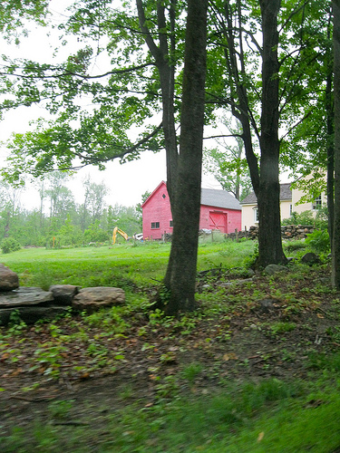
Rural Families Speak
Key Findings from NC223/NC1011
Health outcomes are the result of interactions among a variety of factors at different levels
Many issues such as physical and mental health, food security and nutrition, housing, education, income, and employment are interconnected.

Slide 11
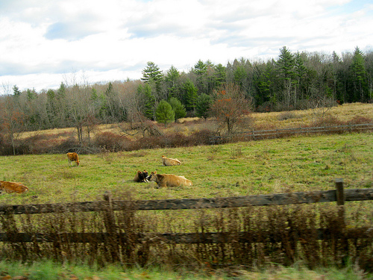
Rural Families Speak
Rural Families Speak About Health
(RFSH)
Goal: To examine the dynamic interactions among individual, family, community, and policy contexts on the physical and mental health outcomes for rural low-income families
2008-2014 (6 years)
Multistate project with 14 universities
Focusing on physical and mental health, nutrition, access to health care (availability, accessibility, acceptability, affordability)
2 waves of data collection
  Wave 1: Quantitative; 2009-2012
  Wave 2: Qualitative; 2011-2013

Slide 12
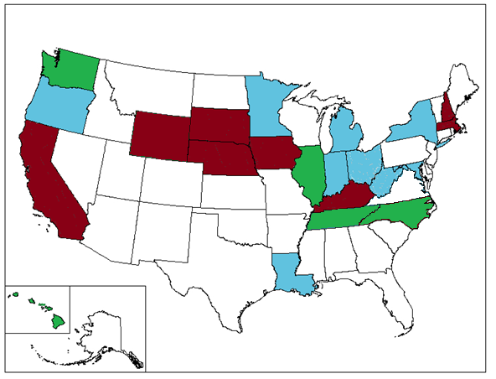
RFS and RFSH Participating states
NH
WA
MA
OR
MN
SD
NY
WY
MI
NE
IA
IL
IN
OH
CA
WV
MD
KY
VA
TN
NC
LA
HI

Slide 13
Rural Families Speak
NIMSS approved NC1171 project continuation
Rural Families Speak About Health
(RFSH)
Goal: To examine the interactions of individual, family, community, and policy contexts on the mental and physical health of diverse rural low-income families
2014-2019 (5 years)
Multistate project with 19 universities
Analyses of previously collected data to explore factors that create barriers or enhance the physical and mental health of rural low-income families
Understand the impact of the Affordable Care Act on rural low-income families. Case studies of mothers and community health care providers.
Dissemination of findings

Slide 14
Multidisciplinary Project Team
Rural Families Speak
Family Economists
Nutrition Scientists
Community Development Specialists
Human Development Specialists
Sociologists
Psychologists
Family Scientists
Faculty—Teaching, Research & Extension appointments
graduate students, research associates, undergraduate students & Extension agents

Slide 15
Multidisciplinary Project Team
Rural Families Speak
Governing Documents
Executive Committee
Chair
Secretary
Vice Chair for Data
Vice Chair for Outreach
Vice Chair for Funding (when needed)
Two year terms of service
Working groups
child health outcomes, family physical health, family
mental health, economic security, training materials development
Administrative Advisor— Karen Shirer, University of Minnesota
USDA NIFA Representative—Alishia Shipley
Annual face to face meeting

Slide 16
Rural Families Speak
Project Outputs
Journal articles
Policy briefs
Research briefs
Dissertations
Masters theses
Presentations
Books
Plays
Book chapters

Slide 17
Rural Families Speak
Researchers Comments
Physical and mental health contributes to present and future well-being
Concerned about their communities
From a family systems perspective, families are affected by the community and vice versa.
Family economic self-sufficiency—partially dependent upon community; rural communities
can lack factors critical to self-sufficiency

Slide 18
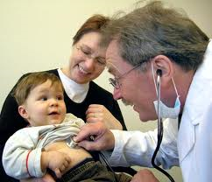
FCS and Rural Development
Rural Families Speak
Holistic approach to serving individual, family and community needs critical especially in rural areas for family well-being and community vitality
“Overall, it has helped us understand the context in which rural families live. This impacts how we as Extension educators do programming.
Findings from this project help us understand the barriers families face—transportation, childcare, time, lack of access to health care, and employment challenges.
This knowledge can impact how we deliver programs as well as help us identify programming content.” Mary Jo Katras, University of Minnesota

